Slide 1
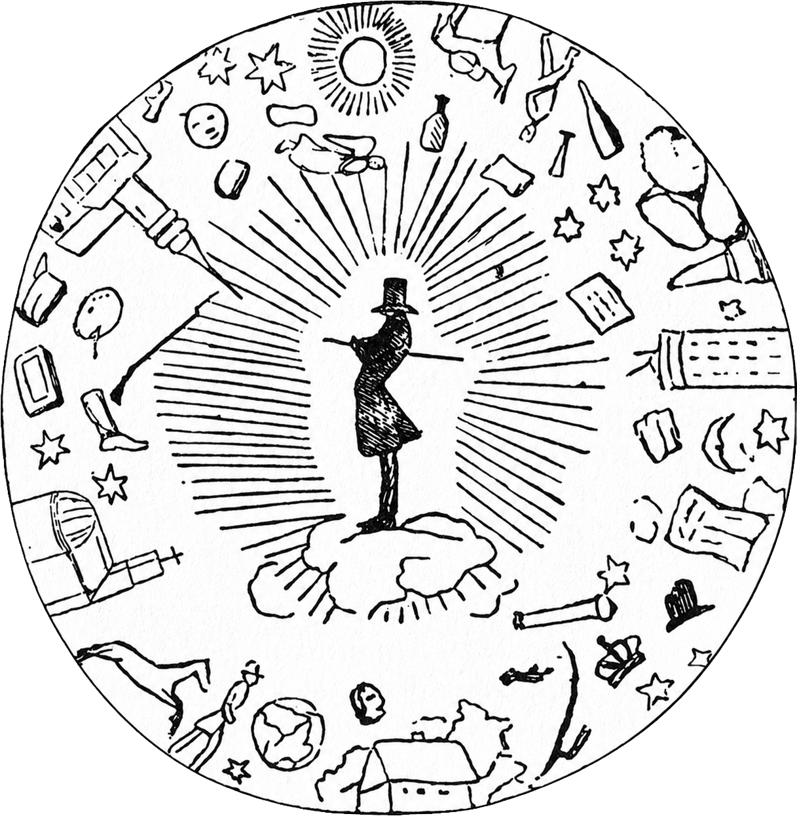

Kierkegaard as a Secret to Himself: Why Totality is Plurality
S.M.D.Th. Wetzels, MSc. MA.
Protestant Theological University Utrecht - Netherlands

Slide 2
Outline of the Presentation
Introduction
  Three quotes, two main questions and one statement
Core argument
  Kierkegaard against the urge for transparency: a taxonomy of secrecy
Some conclusions
  The self as a structural secret: a way to approach Kierkegaard (and ourselves)

Slide 3
quote I
HAS EVERYTHING ALREADY BEEN SAID ABOUT KIERKEGAARD?
  Nihil tam absurde dici potest quod non dicatur ab aliquo philosophorum
Nothing so absurd can be said that it has not been said by some philosopher
    Cicero, De Divinatione II.119; as quoted in Montaigne, Essays II.12, "Apology for Raymond Sebond" (2003, p. 496).
Some philosophical reassurance: a meta-perspective

Slide 4
quote II
What hasn’t already been said about Kierkegaard?
Within only a few generations, a philosopher’s ideas can easily be buried beneath such a vast mountain of commentary, no human life is long enough to dig a path through it to any definite conclusion
      W.F. Hermans (2006), p. 162.
The religious Kierkegaard, the aesthetic Kierkegaard, the existential Kierkegaard, the psychological Kierkegaard, the ironic Kierkegaard, the conservative Kierkegaard, the progressive Kierkegaard, the anti-modern Kierkegaard, the modern Kierkegaard, the Catholic Kierkegaard and so on …

Slide 5
quote III
What has already been said about Kierkegaard?
  Kierkegaard aber ist ein -vielleicht ungläubiger- christlicher Schriftsteller, der in keine Kategorie unterzubringen sein wird, da er die für ihn passende selbst erst ausbildet.
Kierkegaard, however, is a Christian writer – perhaps an unbeliever – who cannot be placed into any existing category, as he is the one who is shaping the category that suits him.
      Heidegger, Anmerkungen I–V (Schwarze Hefte 1942–1948), GA 97, p. 133.
When totality becomes categorization
“More or less consciously, Heiberg and Kuhr lead their readers down the wrong track, so that no mother’s son can see how disconnected and problematical Kierkegaard’s notebooks in fact are.”
Fenger (1980), p. 50

Slide 6
TWO GUIDING QUESTIONS
  (1) Can Kierkegaard’s authorship be understood as a totality without reducing its plurality to a transparent unity?
    The question is whether this plurality should really be treated as a threat to totality, or whether the problem arises only when totality is understood as transparency, coherence and univocity.
  (2) Would Kierkegaard have enjoyed attending this conference?

Slide 7
A paradox
The issue is not that Kierkegaard’s work has not been understood. The issue is that it has been understood in almost every possible way.
  The real problem is not the plurality of interpretations, but the urge to overcome it.

Slide 8
transparantism
    ‘All human beings by nature desire to know’ (Aristotle. Metaphysics. 980a21)
  The ideological process in which visibility, accessibility, and objectifiability are elevated to (normative) principles.
Assumption
  Relationship between visibility and morality
  Hiddenness is a deficiency that must be overcome.

Slide 9
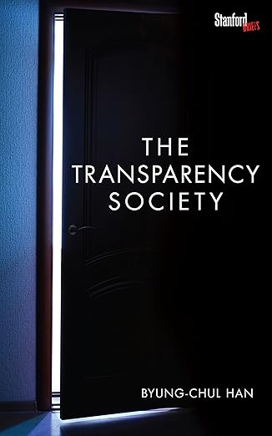
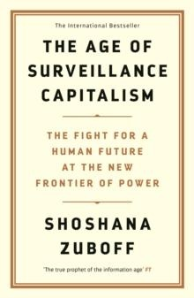
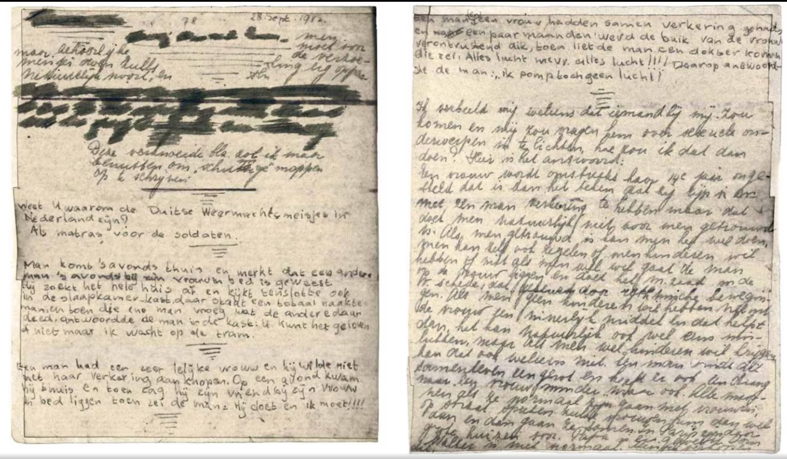
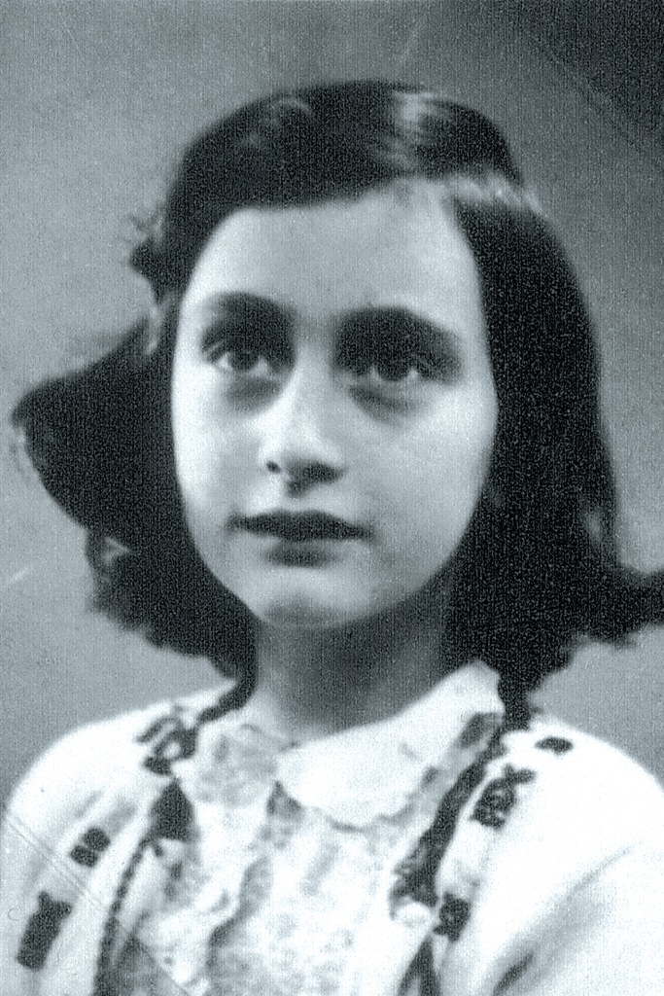
Transparantism: imperative of disclosure
    ‘All human beings by nature desire to know’ (Aristotle. Metaphysics. 980a21)
Contemporary derivative: Neoliberal, data-driven transparentism
    An imperative of disclosure;

Slide 10
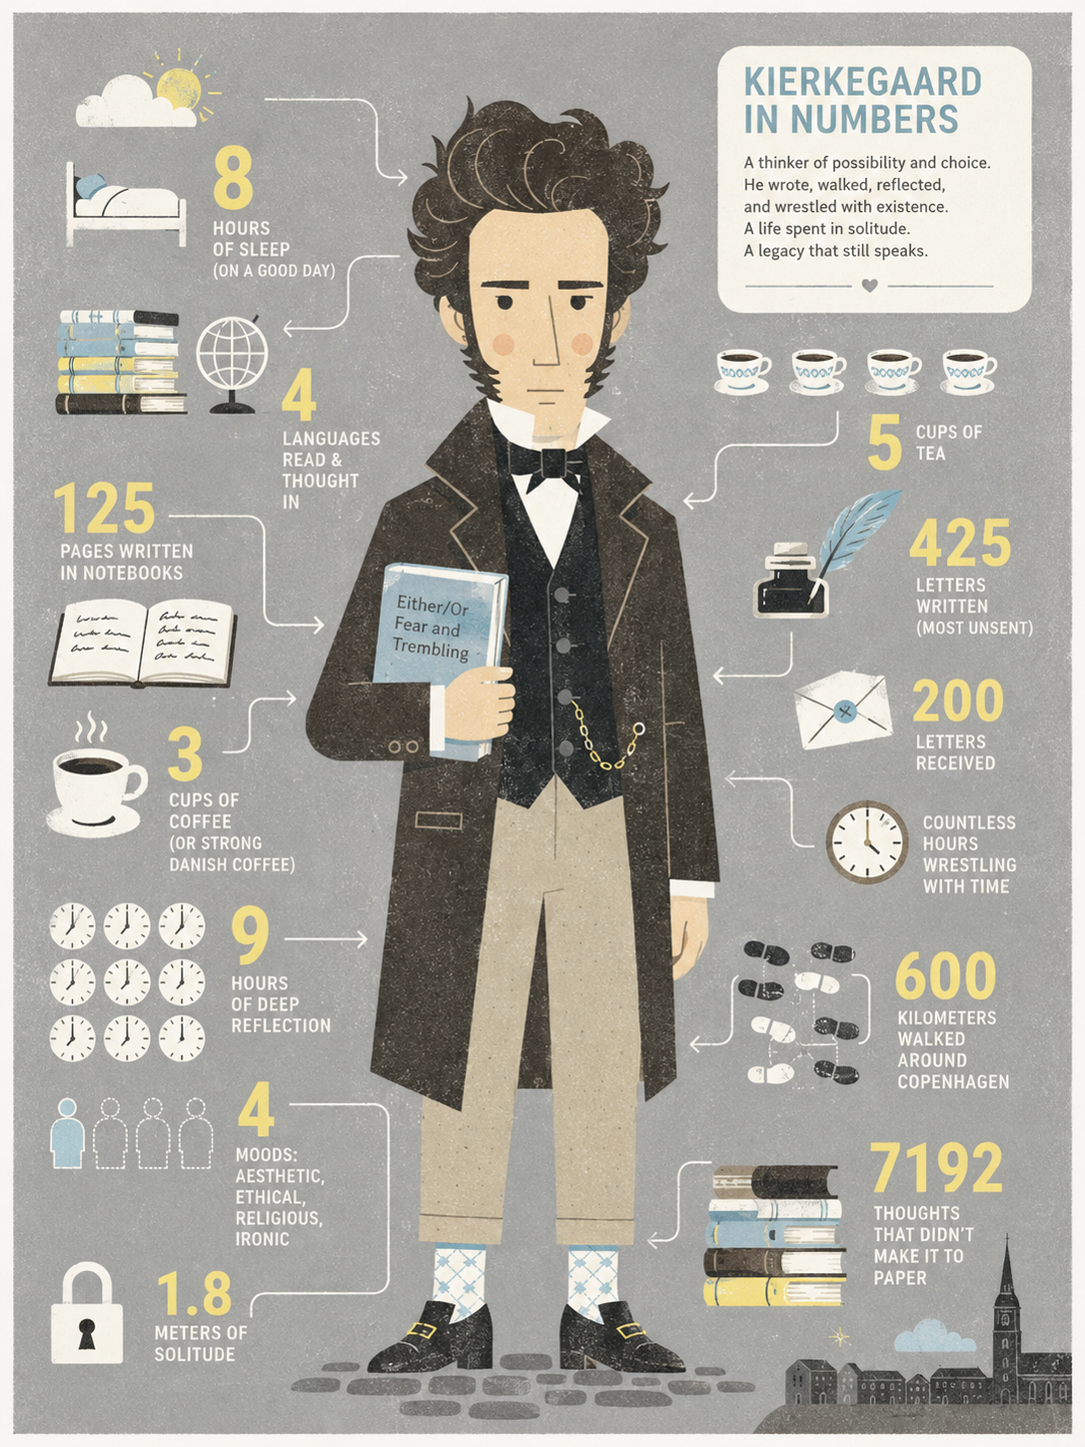
Transparantism: the self as measurable, predictable, and determinate
    ‘All human beings by nature desire to know’ (Aristotle. Metaphysics. 980a21)
Contemporary derivative: Neoliberal, data-driven transparentism
    An imperative of determination
The quantified self:
      the attempt to render a life legible as a single, coherent data set — steps, sleep, mood, etc. — collapsing what is plural and ambiguous into one measurable totality.
The numerical’s law of existence is: they live comparatively
      NB33:15 / SKS 26, 257.

Slide 11
Hermeneutical form
  Opacity, inconsistency, and plurality appear as problems in understanding an author and his work.
Risk in Kierkegaard interpretation
  The search for the “real” Kierkegaard becomes the search for one coherent, transparent authorial centre.

Slide 12
TOTALITY AS PLURALITY
  Plurality is the form of totality itself.
  Rejecting arbitrariness is not the same as rejecting plurality.
  Self-fragmentation evades responsibility; existential plurality intensifies it.
Vær Piat, hav idag een Anskuelse, imorgen en anden, (...) og Du skal see, alle Vanskeligheder forsvinde.
SKS 13, 381

Slide 13
Why Does the Authorship
Take This Plural Form?
  The self is not a finished substance
    The self is relation, synthesis, task, and becoming
    Kierkegaard’s authorship is an expression of this
  No single transparent interpretation can exhaust totality

Slide 14
The Secret as an
Existential Category
  Understood as ‘what is hidden’
  Challenges transparentism by exposing the impossibility of totality without remainder.

Slide 15
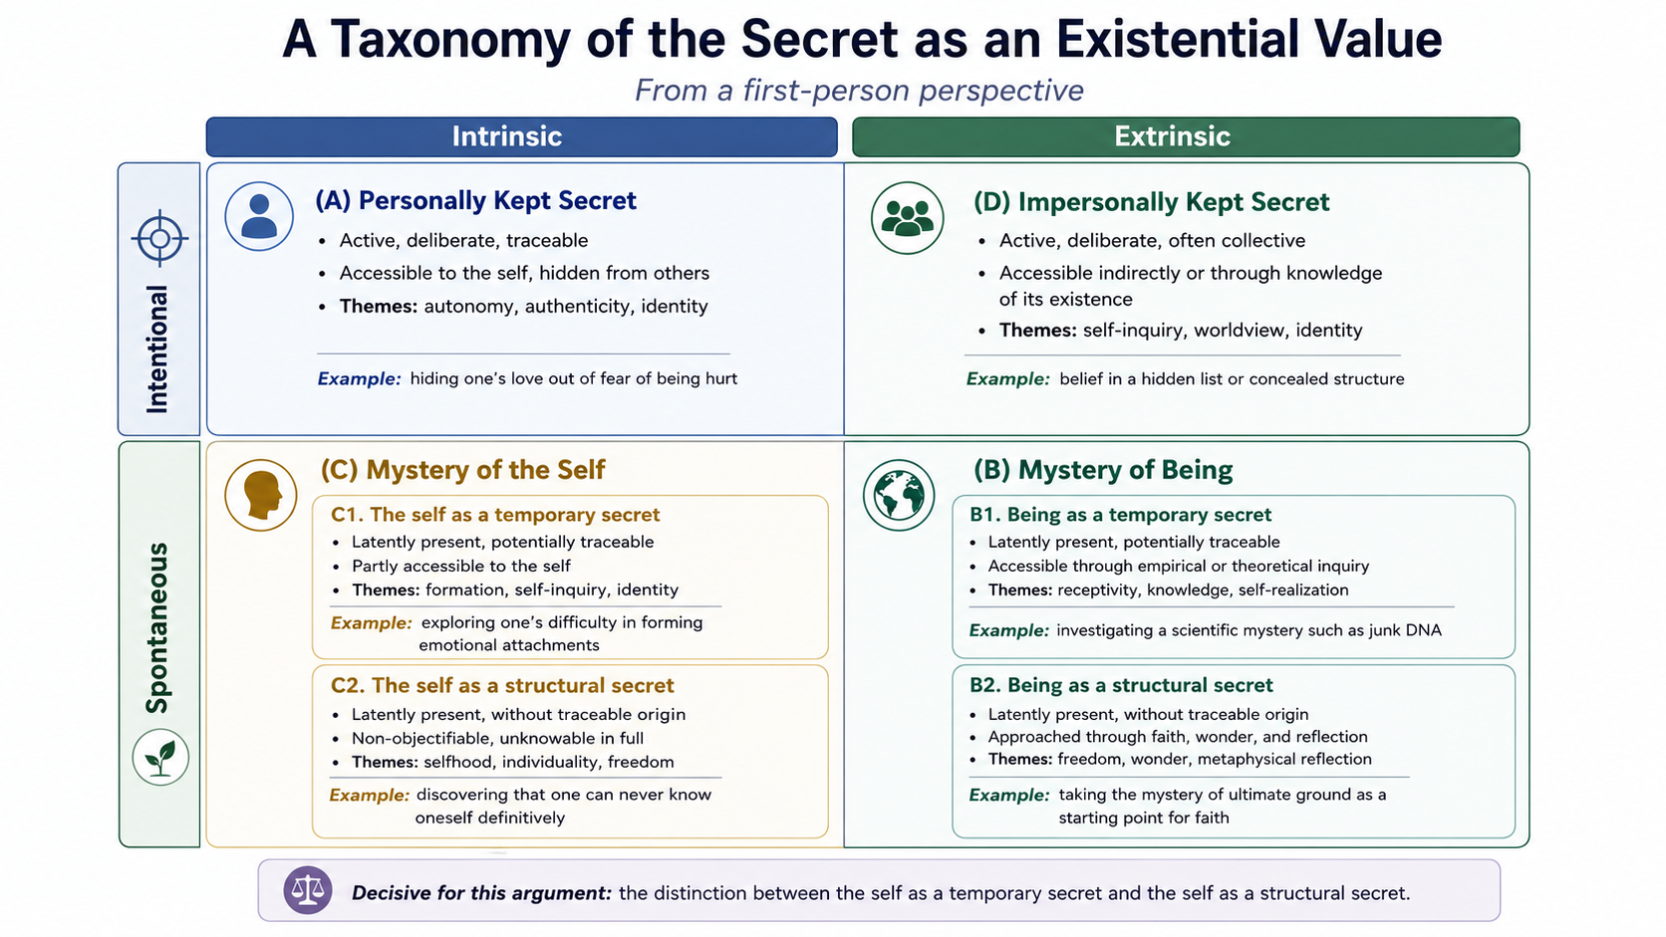
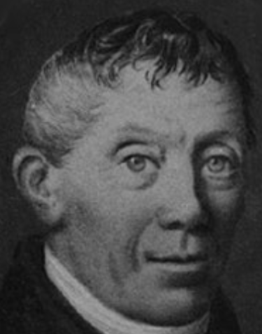
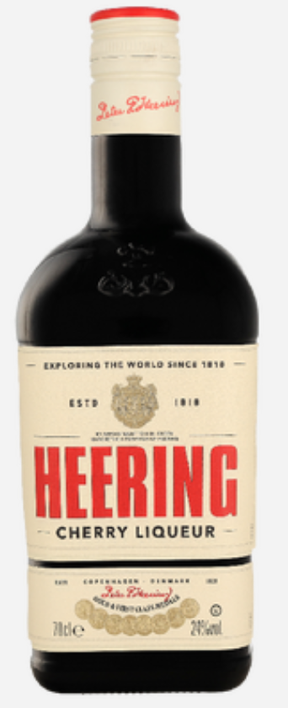
© Stephan Wetzels

Slide 16
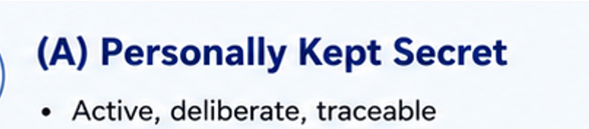
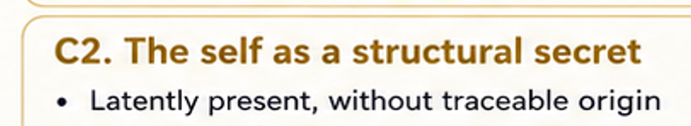
What Kind of Secret Is at Stake in the Self That Writes?
  Journals and notebooks:
      Not a hidden archive of “the real” Kierkegaard
      Not category A, but C2

Slide 17
Some conclusions

Slide 18
CAN KIERKEGAARD’S AUTHORSHIP BE UNDERSTOOD AS A TOTALITY WITHOUT REDUCING ITS PLURALITY TO A TRANSPARENT UNITY?
Kierkegaard’s plurality is not a defect or a problem to be overcome.
The self is a structural secret: never fully transparent to itself or others.
Hermeneutical shift: interpretation shouldn’t decode ‘a hidden reality’, but attend to how the structural secret of the self appears through plurality.
The journals testify to provisional self-becoming — and to the reflection on that self-
Totality therefore cannot mean univocity, closure, or a transparent authorial centre.
Kierkegaard’s authorship is a totality precisely because its unity appears as plurality. No need to protect him from that.

Slide 19
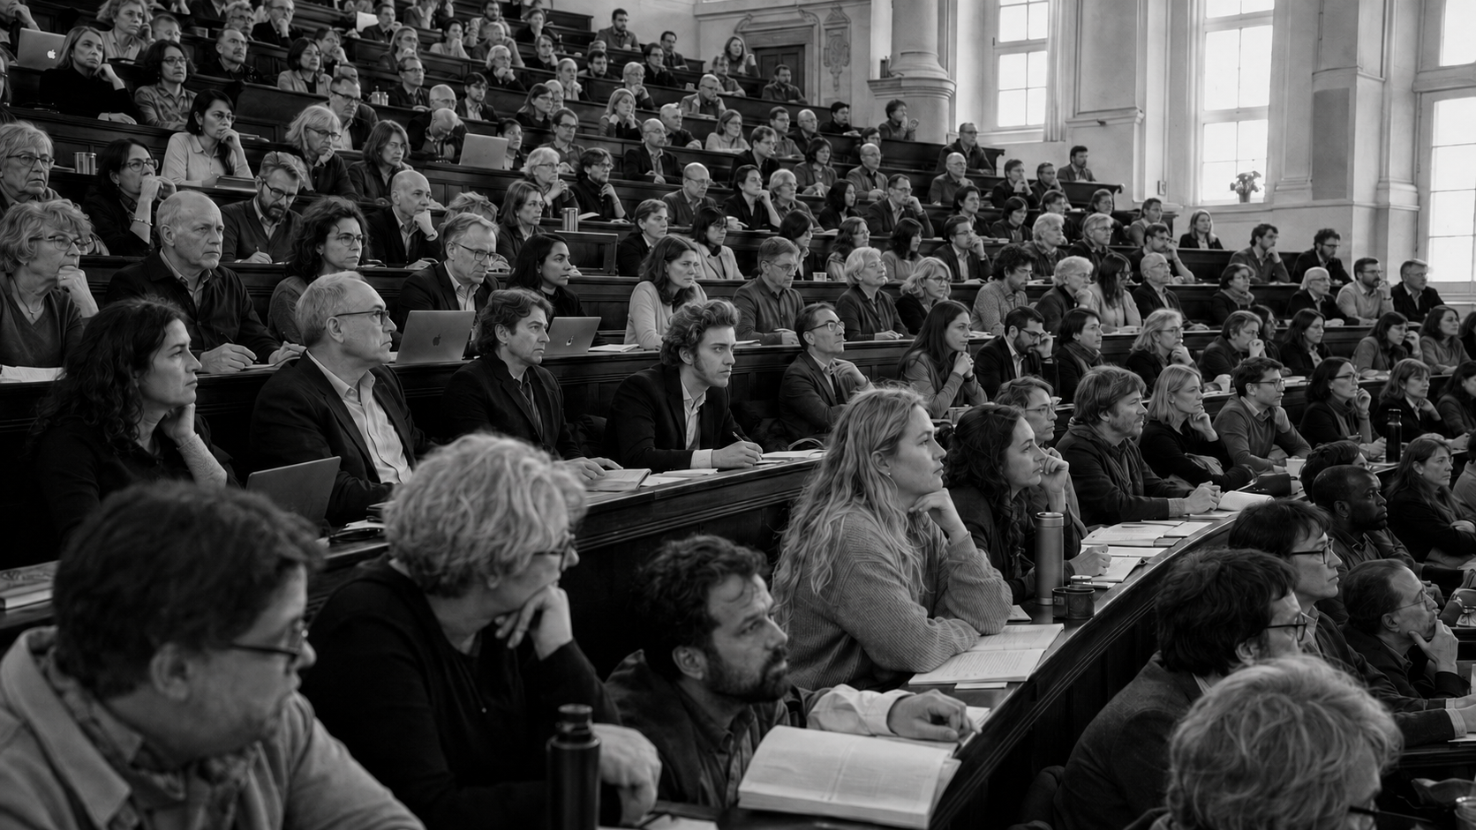
  WOULD KIERKEGAARD HAVE ENJOYED ATTENDING THIS CONFERENCE AS SPECTATOR?

Slide 20
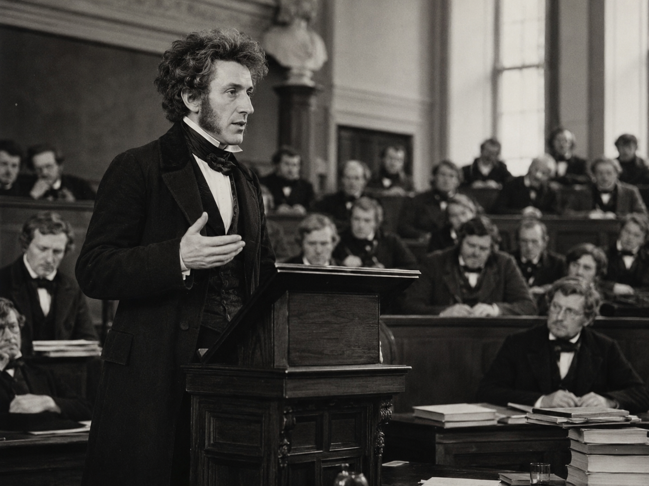
  WOULD KIERKEGAARD HAVE ENJOYED ATTENDING THIS CONFERENCE AS SPEAKER?

Slide 21
Thank you very much

